Slide 1
Revised Budget 2023
Finance, Audit and Risk Committee Meeting
25th May 2023

Slide 2
Introduction
As desired by the Board, following launch of the revised structure:
  Revised budget to be submitted to C-FAR/ Board (in May/ June 2023)
  Not to go beyond the unrestricted core approved envelope (i.e. US$ 20,992K)
All figures in US$ ‘000, unless specifically stated otherwise.

Slide 3
High Level Changes
Revised plan and budget incorporates
  Incorporate costs of realigned structure, transition support and redundancies.
  Add new projects signed off after the original plan and budget approved.
  Edit (wherever required) key indicators - align these with the new strategy.
  Identify three high-level risks that could inhibit implementation.
  Identify any savings and/or adjust budgets due to timing and/or add budgets for the new projects
Additional activities added to take forward some of the critical initiatives:
  US$ 140k, @ US$ 20k for each MA facing unit/ division for travel.
  US$ 200k cover (partly) regional meetings - Brand/ Charter/ Strategy Adoption
  US$ 225k to cover Anti-Racism work.
US$ 500k requested allocation (from general reserves) for training and induction of staff in the realigned structure.

Slide 4
Planning Projects
Total Projects
Light Planning: 186
Updated: 207

Slide 5
Planning Projects
Total Projects
Light Planning: 186
Updated: 207

Slide 6
Overall Impact of Revised Budget - Threshold
 | Budget (original) | Budget (Revised)
Core Income | 62,834K* | 68,275K
Secretariat cost (unrestricted core) | 20,992K | 20,731K
Secretariat budget as a % of unrestricted core income | 33.4% | 30.4%
(Deficit drawn down from reserves)/ Surplus | (2,042K) | 6,302K
*$62,834K includes drawdown from reserves of $2,042K – in the revised budget % calculated on projected income in 2023.
Overall threshold in % and absolute terms lower than the original budget 2023.
Risk (on income side)
  Sweden unrestricted core income grant most likely to drop significantly.
  Norad unrestricted core income grant agreement not yet signed off but received communication of higher allocation than budgeted (US$ 900k).

Slide 7
Overall Projected Impact on Funds
Source of Funding | Opening Balance (1st Jan 23) | Budget (revised) | Closing Balance (31st Dec 23)
General Reserves | 20,894K | 6,302k | 27,196k
Designated Funds | 31,709K | 14,611k | 17,098K
Restricted | 24,143K | 12,670k | 11,473K
Overall fund balance across all sources to remain positive

Slide 8
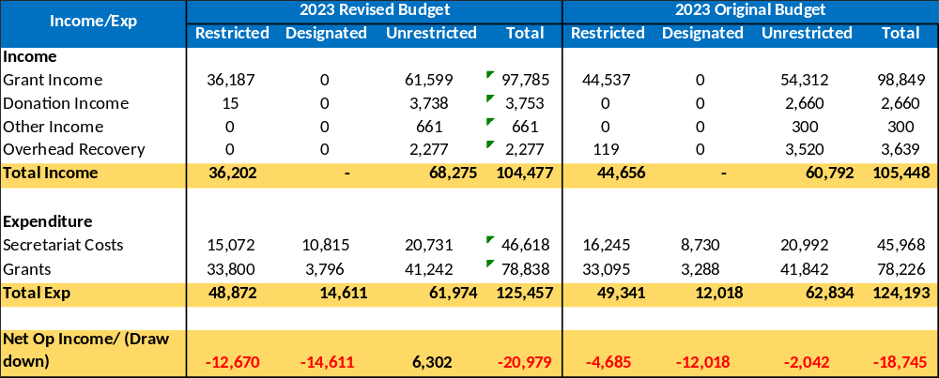
Revised vs Original Operating Budget - Summary
Unrestricted core surplus US$ 6.3 Mn as compared to a deficit of US$ 2.042 Mn.
Restricted funds draw down higher at US$ 12.670 Mn as compared to US$ 4.685 Mn.
Designated funds draw down higher at US$ 14.6 Mn as compared to US$ 12.018 Mn (Please note, FP 2030 and PRIMCCM projects were not considered under hosted category in the original budget but are in the revised budget)

Slide 9
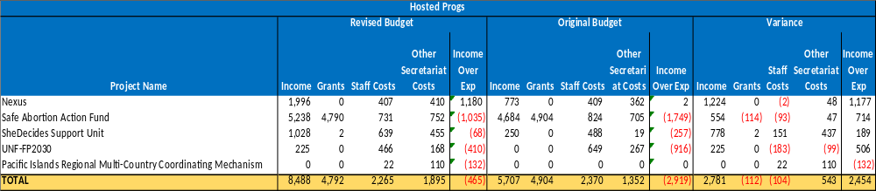
Hosted Progs Summary
UNFP 2030 and PRIMCCM projects were not considered under hosted progs in the original budget
In 2023, income and expenditure for FP 2030 as per communications received from ESEAOR should have been $1.158Mn. However, $934K of income and the activities budget has not been input by ESEAOR into the budgets.

Slide 10
Ask from the C-FAR
Recommend to the Board of Trustees approval of the following designations:
  US$ 200k for moving ACRO office from Columbia to Mexico.
  US$ 500k for induction and training of staff.
Recommend to the Board of Trustees approval of:
  Revised plan and budget for 2023

