Slide 1
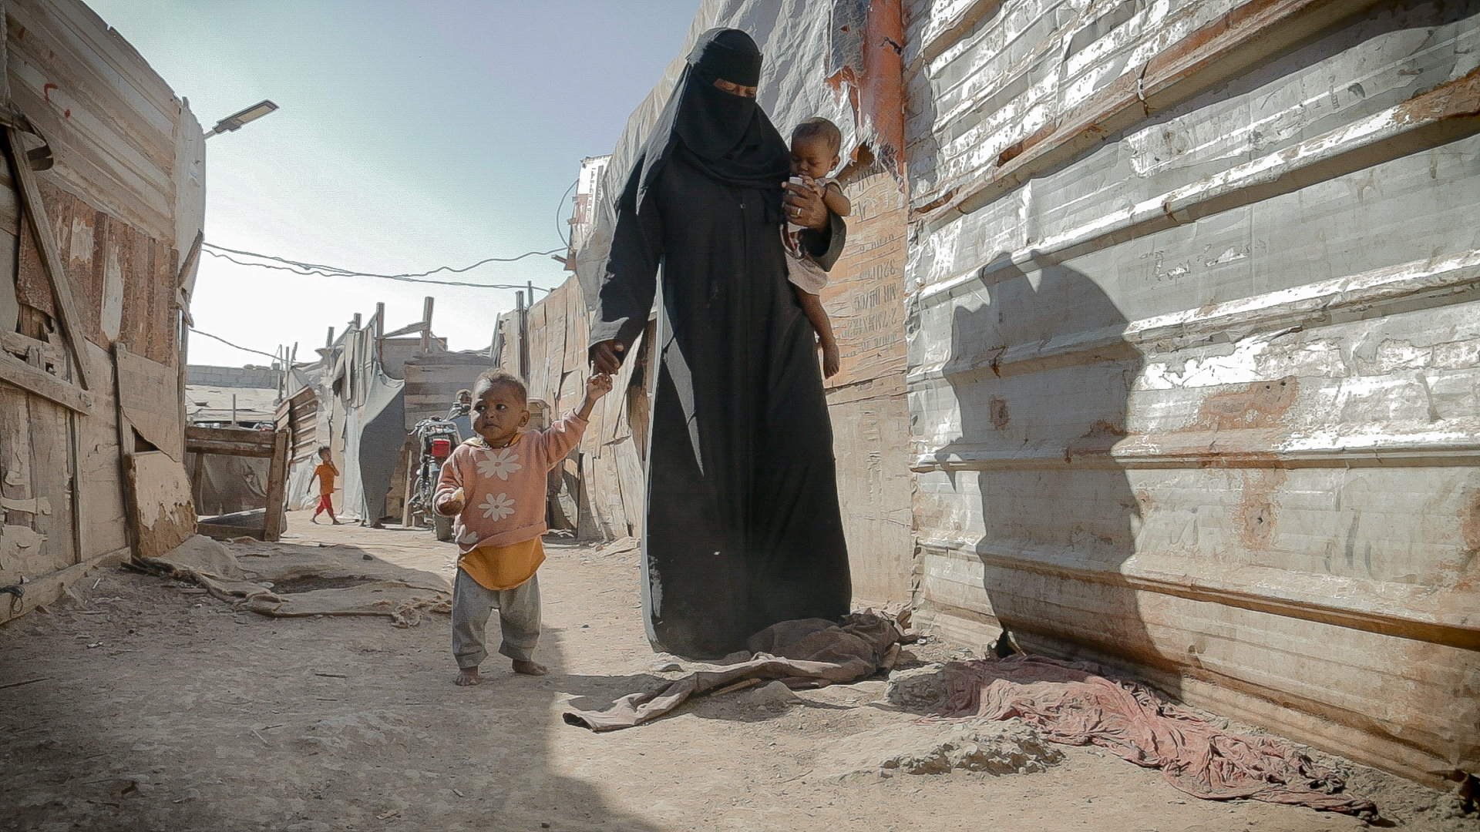
Stream 3: HER Fund Overview in 2024

Slide 2
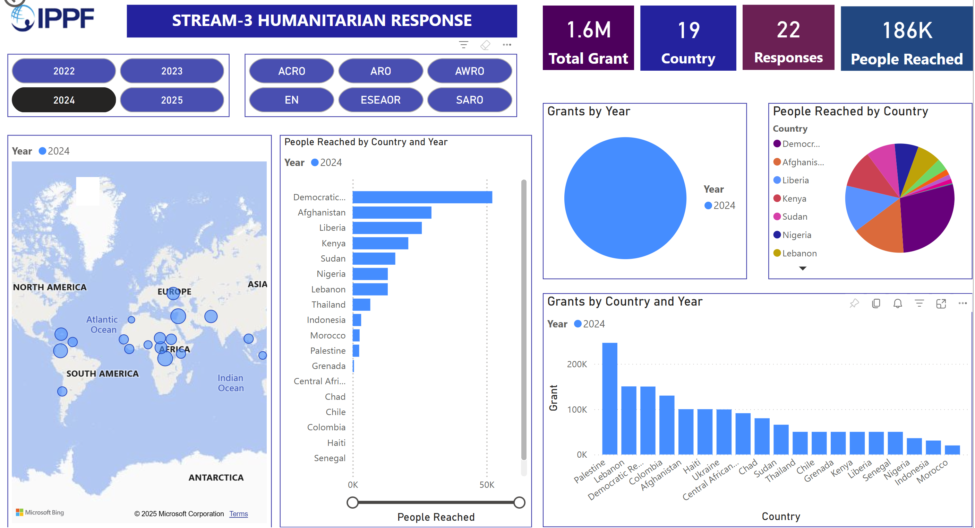

Slide 3
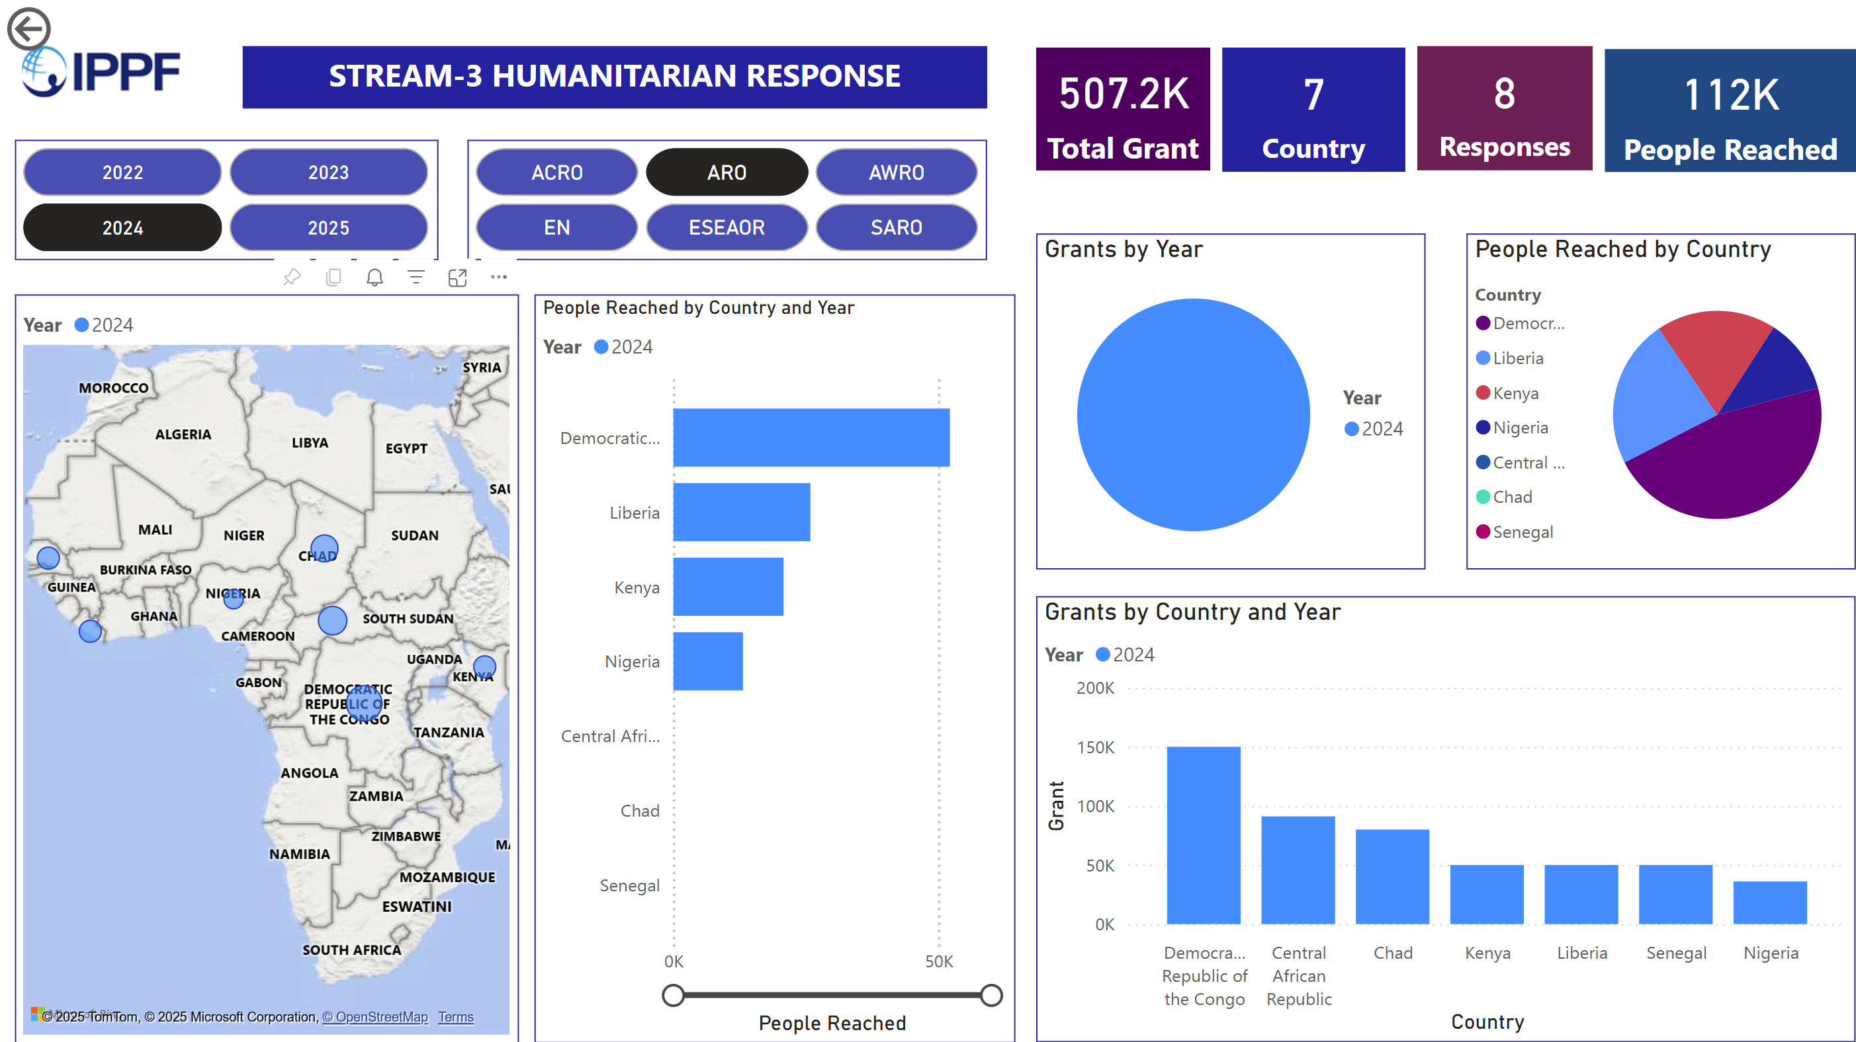

Slide 4
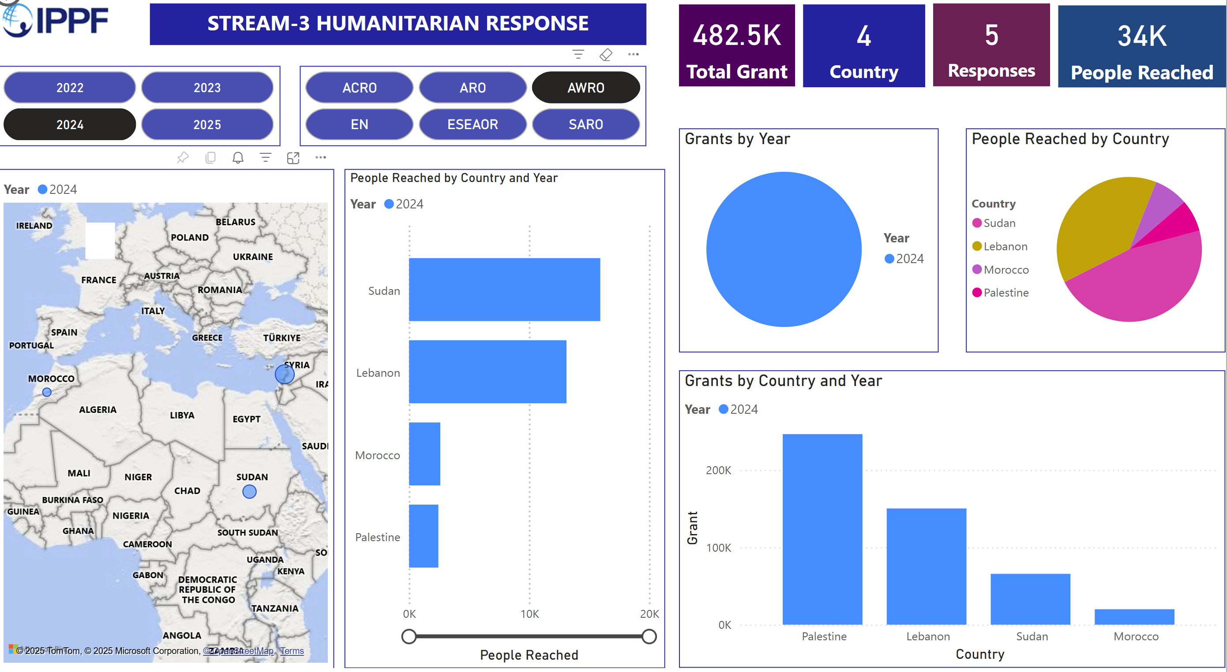

Slide 5
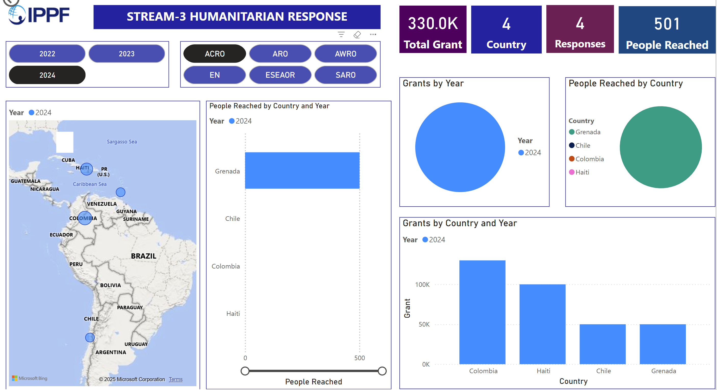

Slide 6
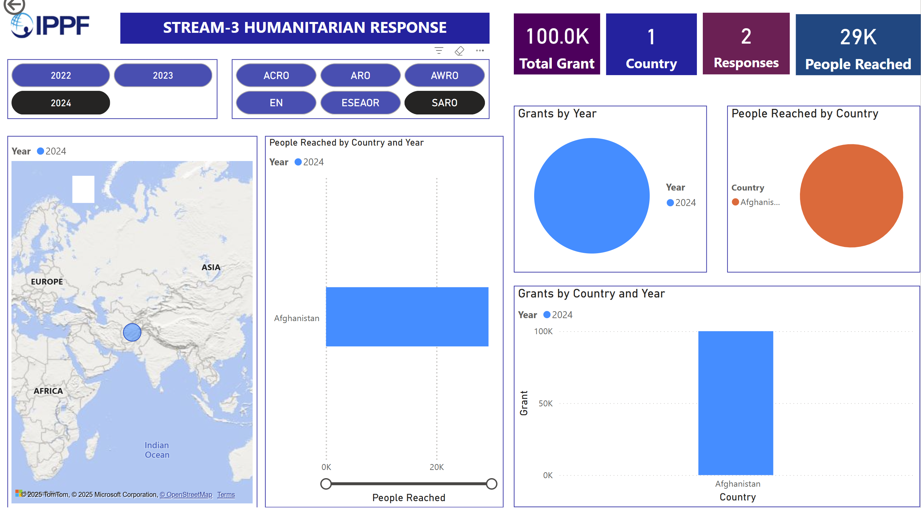

Slide 7
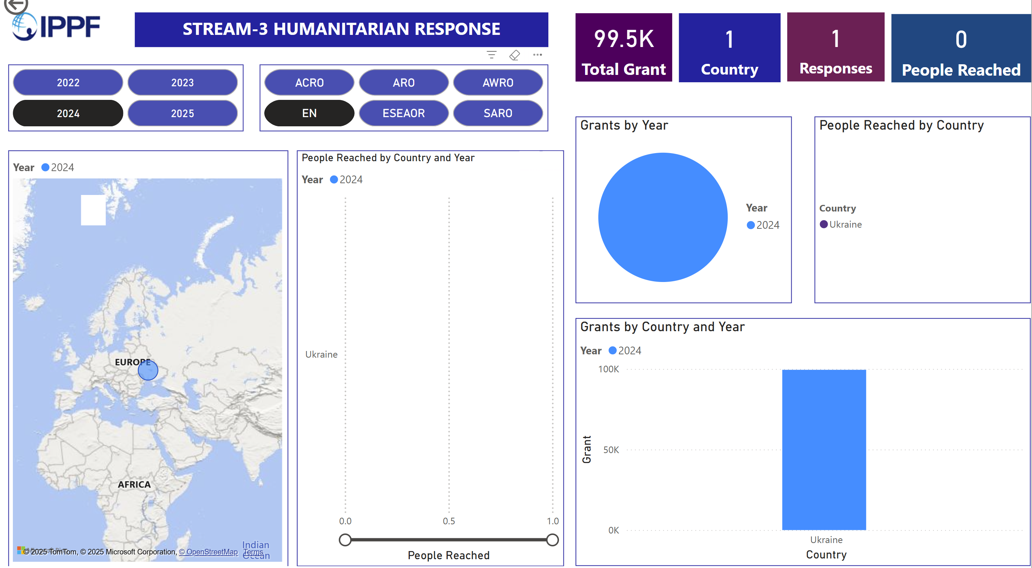

Slide 8
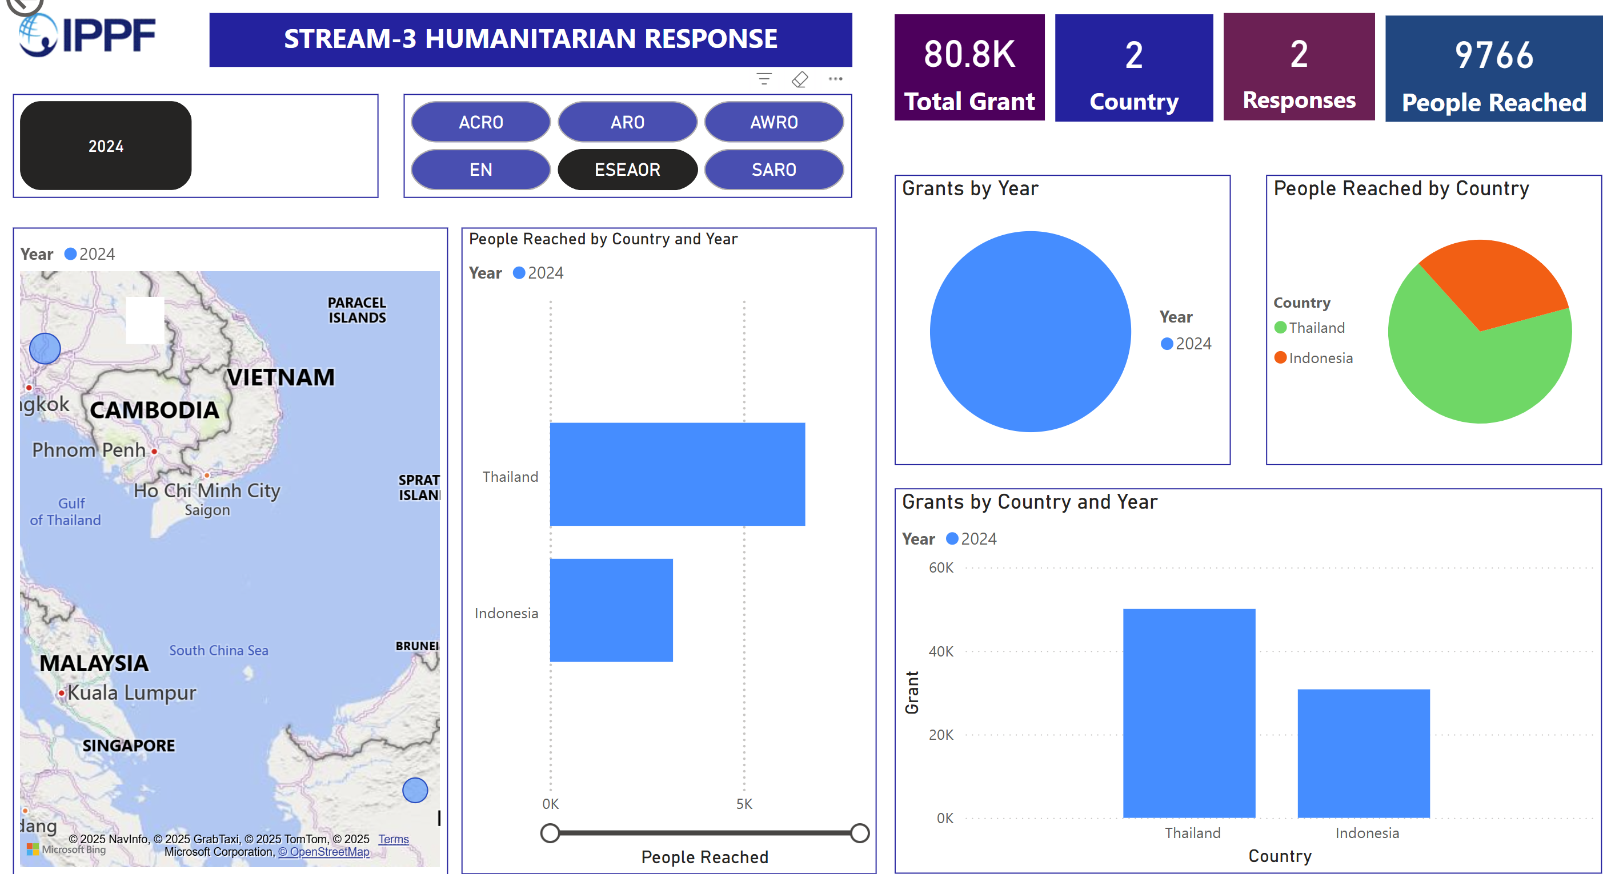

Slide 9
What went well
Faster in responding to the MAs for STREAM 3 funding
Coordinated work between RO, MAs and GHT
MAs understanding of the finding mechanism so more applications to it
Funding was increased by 400K due to the number of responses

Slide 10
Recommendations
STREAM 3 Guidelines need to be reviewed matching reality and proposed to DLT/BoT and reflect MAs reality in a crisis response
NEED To Increase stream 3 funding is needed
Develop a funding mechanism for donors to participate in this funding mechanism

