Slide 1


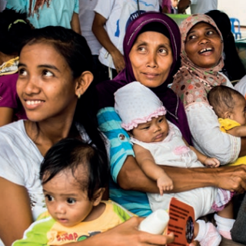
Secretariat Accountability Mechanism
June 2025
Notes:
Stef - welcome

Slide 2
SAM Overview and Process
Purpose
Methodology
Process - 2024
Accountability areas
Process for holding the Secretariat accountable.
MAs and CPs provide feedback on how well the Secretariat is doing across 7 accountability areas which are assessed against 4 criteria: Timeliness, Relevance, Quality, Effectiveness
Feedback will be used by the Secretariat to better meet the needs of MAs and CPs
Survey and focus group discussions
Designed by task force including Secretariat staff and MA representatives.
Piloted in January 2023 with a sub-set of MAs, to test and refine.
Survey open to all MAs and CPs from Sep - Nov 2023
Repeated every three years aligned with Secretariat's business planning cycle
March: DLT reviewed initial survey findings
April: FGD with nominated MAs/CPs representatives
May: Final analysis and consolidated reporting of survey and FGD data
May/June: Developed management response and action plans
July: Dissemination to Secretariat
Aug – Oct: Global and regional reports finalised
Nov: Dissemination to MAs/CPs
Technical leadership and capacity sharing
Knowledge exchange and learning
External engagement and strategic partnerships
Financial sustainability and resource mobilization
Safety and inclusion
Efficiency and communication
Governance and strategic leadership
7 accountability areas assessed against 4 criteria: Timeliness, Relevance, Quality and Effectiveness
Notes:
The Secretariat accountability mechanism provides an opportunity for MAs and CPs to provide feedback on how the Secretariat is doing across 7 accountability areas – which you can see in the purple box in the middle.
The Secretariat is using this feedback to strengthen how we work with and meet the needs of MAs and CPs
The main data collection took place last year with a survey in in Arabic, English, French, and Spanish sent to all Mas. We were encouraged by a strong response across regions with 90 MAs responding. We then conducted FGDs in May of this year to delve deeper into key areas. There were 43 participants in the FGDs across senior leadership from MAs and youth representatives
The DLT and key stakeholders prepared a management response and action plan which has been shared with you and will be shared with MAs once we have translated / designed versions (Dorothy will talk more about this later in the presentation).

Slide 3
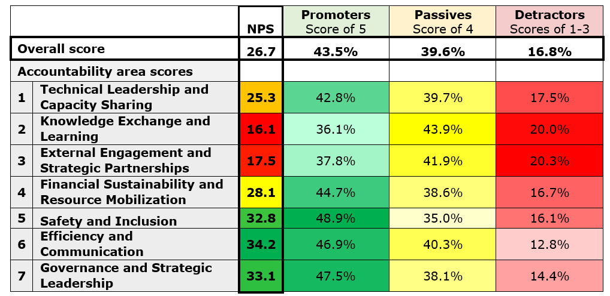
Global Scores: Accountability Area
Notes:
Key global findings
Accountability areas
The accountability areas with the highest scores at the global level are 6. Efficiency and Communication, 7. Governance and Strategic Leadership, and 5. Safety and Inclusion indicating that MAs/CPs are most satisfied with the Secretariat’s support in these areas.
The accountability areas with the lowest NPS at the global level scores are 2. Knowledge Exchange and Learning and 3. External Engagement and Strategic Partnerships, indicating that MAs/CPs are less satisfied with the Secretariat’s support in these areas.
As mentioned in the paper, it is important to note that global scores are unweighted and could be biased towards regions with more respondents.
NPS Calculations
The NPS can range from -100 to +100 and is calculated by subtracting the percentage of ‘Detractors’ (those who gave a rating of strongly disagree, somewhat disagree, or neither agree nor disagree) from the percentage of ‘Promoters’ (those who gave a rating of strongly agree). ‘Passives’ (those who gave a rating of somewhat agree) are not included in the calculation. This sets a high standard, aiming for a response of ‘strongly agree’ and aids in identifying key focus areas for improvement.

Slide 4
Common themes
Capacity building and professional development: Customize capacity-building programmes to meet the specific needs of each MA/CP. Knowledge exchange and collaborative networks: Create online platforms and forums to facilitate the sharing of resources, best practices, and technical knowledge, including knowledge exchange networks where MAs/CPs can learn from each other’s successes and challenges, including youth-friendly forums. Strategic partnerships and external engagement: Strengthen and diversify strategic partnerships with various stakeholders at global, regional and local levels to support the Federation's mission. Financial management and sustainability: Develop comprehensive fundraising strategies, strengthen capacity in financial management, foster partnerships for resource sharing and joint funding opportunities, and support social enterprise initiatives and marketing strategies. Governance, communication, and inclusion: Enhance governance practices, develop a comprehensive communication strategy, promote a culture of inclusion and respect, and establish comprehensive security safety and inclusion policies, and support to ensure adherence to standards. Collaborative partnership: There is recognition that the Secretariat acts as a directive body, a resource provider, and a collaborative partner. There is a strong desire for it to engage more as a collaborative partner. Adaptation to strategic changes: More gradual implementation of changes would allow for better adoption, adaptation and uptake. Feedback indicates that implementing changes too rapidly causes delays and doesn’t provide for a period of adjustment.
Notes:
There were several common themes that came out across the accountability areas and in the recommendations.
(Capacity building and professional development:) Areas flagged for capacity building include support to apply for funding, financial management, partnership building, advocacy and in technical / clinical areas. One way which MAs called for doing this was exchange programmes across MAs…which links to the next point on strengthening:
Knowledge exchange and collaborative networks: through promoting a culture of collaboration and sharing to galvanize opportunities for MAs/CPs to learn from each other’s successes and challenges. A specific focus on forums and channels that respond to how young people prefer to engage was flagged.
On Strategic partnerships and external engagement, MAs would value more collaboration with the Secretariat on advocacy and on identifying new partnership opportunities for MAs/CPs – importantly, of course, with MAs being fully engaged in identifying any new partnerships
The recommendations on Financial management and sustainability cover a range of areas as shown in point 4 – several of which are already included in and are aligned with Secretariat deliverables – and will be fleshed out in the management response / action plan.
On Governance, communication, and inclusion, key points that came out in the FGDs indicate a need to ensure the current governance structure / processes of IPPF are clear to MAs. There is also a call for the Secretariat to work more with MAs on establishing comprehensive security policies and approaches given the challenging contexts many are working in with anti-rights groups.
(Collaborative partnership:) The point on collaborative partnerships involves being more receptive to feedback from MAs, considering their insights in decision-making processes, and providing support to MA operations and activities rather than dictating how things should be done. In the FGDS, there were lots of examples of how this is already happening, and a call for this to continue and be more central. And, finally, a point that came out in the FGDs was the scale / pace of change through the Secretariat restructure and launch of the Come Together Strategy. Change is hard…and,
(Adaptation to strategic changes:) Feedback indicates that in some cases, changes were implemented too rapidly which didn’t allow for a period of adjustment.
Across these areas, there were
Calls for more ‘relevance’ – e.g. ensuring training, support, responses, etc are tailored to the needs of the very different contexts that MAs work in.
And, there were focused calls from young people to ensure that approaches align with their preferences / modalities of communication and engagement; that their voices are considered and central to defining programming, etc; and that they have more direct access to the Secretariat, e.g. that communications with youth working with MAs doesn’t always go through the ED/PD of the MA.

