Slide 1

Implications of the ‘America first global health strategy’ for ippf.
February 2026
Donor Advisory Group

Slide 2
America first global health strategy:
Components:
AFGHS
Making America Stronger
Making America more Prosperous
Making America Safer
Rationale:
Inefficiency and waste
Culture of dependency
Leveraging to compete with China

Slide 3
Memorandums of understanding: September 2025 - today
- September 2025
UNGA and start of Negotiations
* - November 2025
Africa Tour by USG
Raising the Alarm: Concerns Raised:
Helms (Template)
Data sharing (Tech. Guidance)
Future policy adjustments (Tech. Guidance)
Focus on faith-based partners (Template)
Co-financing from recipient governments (Template)
Impact of expanded GGR
Access to minerals
Change in human rights paradigm

Slide 4
Memorandums of understanding: September 2025 - today
- December 2025 and January 2026: Signing of Agreements
Country | USG investment | Country co-financing
Kenya – Dec. 4th | $1.6B | $850M
Rwanda – Dec. 5th | $158M | $70M
Liberia – Dec. 9th | $125M | $51M
Uganda – Dec. 10th | $1.7B | $500M
Lesotho – Dec. 10th | $232M | $132M
Eswatini – Dec. 12th | $205M | $37M
Mozambique – Dec. 15th | $1.8B | $70.6M
Cameroon – Dec. 16th | $400M | $450M
Nigeria – Dec. 20th | $2.1B | $3B
Sierra Leone – Dec. 22nd | $129M | $44M
Ethiopia – Dec. 23rd | $1B | $450M
Madagascar – Dec. 23rd | $134M | $41M
Botswana – Dec. 23rd | $106M | $381M
Cote d’Ivoire – Dec. 30th | $487M | $450M
Malawi – Jan. 14th | $792M | $173.8M
Total | $11B | $6.6B

Slide 5
Reviewing the mous: Kenya and Mozambique
Kenya
Mozambique
HELMS:
Language included.
DATA SHARING:
Separate agreements: (financing agreement (s), data sharing agreement, specimen sharing agreement)
CO-FINANCING:
DRM – no donor or multilateral sources.
JOINT STEERING COMMITTEE:
Only stakeholders agreed by the USG and GOK.
OTHER PARTNERS:
Sunsetting all implementing partners outside of the government – to – government mechanism (excl. faith-based providers)
HELMS:
Language included.
DATA:
CO-FINANCING:
DRM, no donor or multilateral sources
JOINT STEERING COMMITTEE:
Only stakeholders agreed by the USG and GOM

Slide 6
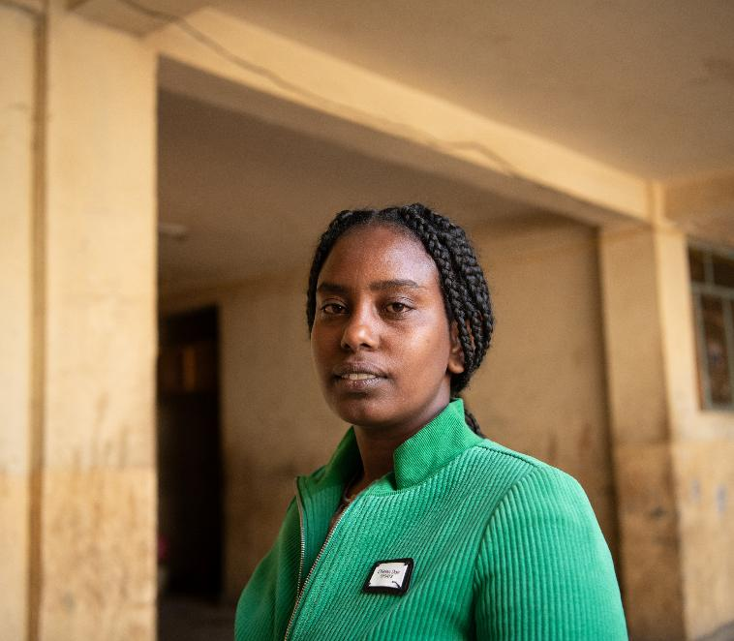
Jan 2026: promoting human flourishing in foreign assistance (phffa).
Expansion of Mexico City Policy
Applies to all non-military foreign aid.
Restricts advocacy and speech related to three areas:
Protecting Life in Foreign Assistance
Combating Gender Ideology in Foreign Assistance
Combatting Discriminatory Equity Ideology in Foreign Assistance.

Slide 7
Jan 2026: promoting human flourishing in foreign assistance (phffa).
Application to different entities
Application to Foreign Governments and Parastatals:
“A foreign government or parastatal that receives or implements a grant or cooperative agreement for foreign assistance will not be subject to the same award terms as a foreign or U.S. NGO… However, a foreign government or parastatal may be required to agree that, during the period of the award, it will not use foreign assistance funds under this award to promote discriminatory equity ideology or to engage in unlawful DEI-related discrimination”.

Slide 8
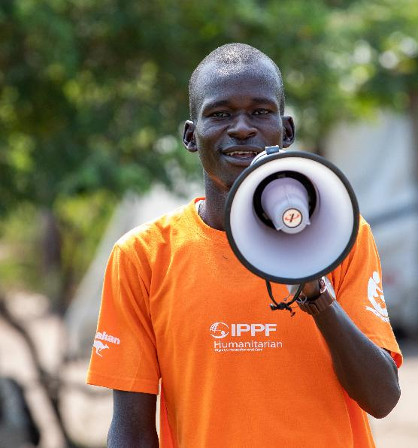
MA action.
Challenges:
individual country approach
Access to MOU text (secrecy, trust, reluctance to share among CSOs)
USG/recipient country narrative
Collection of country actions:
* Coalition building at the national level for collective response, solidarity, and safety. Building a contextualized approach (CSO community, journalists, Missions, MoH)

Slide 9
MA action.
Action:
Legal support:
Due process
Data protection
Budgetary implications
American vs national business interests
Legislative landscape
Communication:
Messenger?
Understanding national sentiment

Slide 10
Going forward: navigating the road ahead
Way forward for CSOs will depend on the country context, space for CSOs and strength of institutions:
Government allies (exclusions, understanding and implications)
Parliamentary groups and pressure (due process, elections)
Legal actions (current process, policies, legislation, and independence and strength of judicial institutions)
Legal support (expanded GGR, interpretation and reaction of governments)
Communication and advocacy (awareness raising among diverse groups of CSOs, external and the reputation of CSOs)
Evidence and documentation (budgetary, service delivery, policy/legislative changes, human rights abuses)
Partnerships for better expertise
Beyond the national: country to country exchange, regional level, asks from cooperation partners, preparing other regions. (Push to division, must resist this)

