Slide 1

Trends in Affiliate budgets 2026

Slide 2
Process

Slide 3
Resource Allocation Model
Unrestricted
Strategic Funds
Stream 2:
Strategic Fund
(Max 15%)
Stream 3:
Humanitarian Response
(max 5%)
Stream 1:
Core Support
(Min. 80%)
Notes:
The Consortium Channel is part of Stream 2 of our new resource allocation model, which was developed during the 2019/2020 reform process.
Stream 2, is devoted to strategic initiatives. It is also known as the Strategic Fund. The fund allows IPPF to capitalize on emerging trends or opportunities within a strategic period; or to react to unforeseen barriers.
The stream is split into four channels: outlined here. The largest by far is the Consortium channel, which this year has 2.2m devoted to it for a 2-year implementation cycle.
The consortium channel will have a call for concepts every year; each with a different theme, as decided by the IPPF Board, via its Committee for Strategy, Investment and Policy.
The funds are exclusively available for IPPF Members and partners. The role of the secretariat is a supportive and facilitative one.

Slide 4
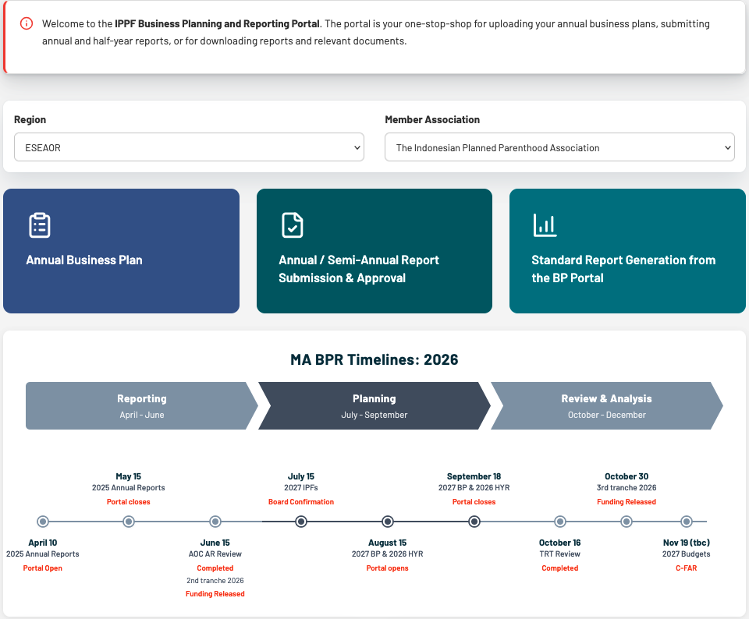

Slide 5
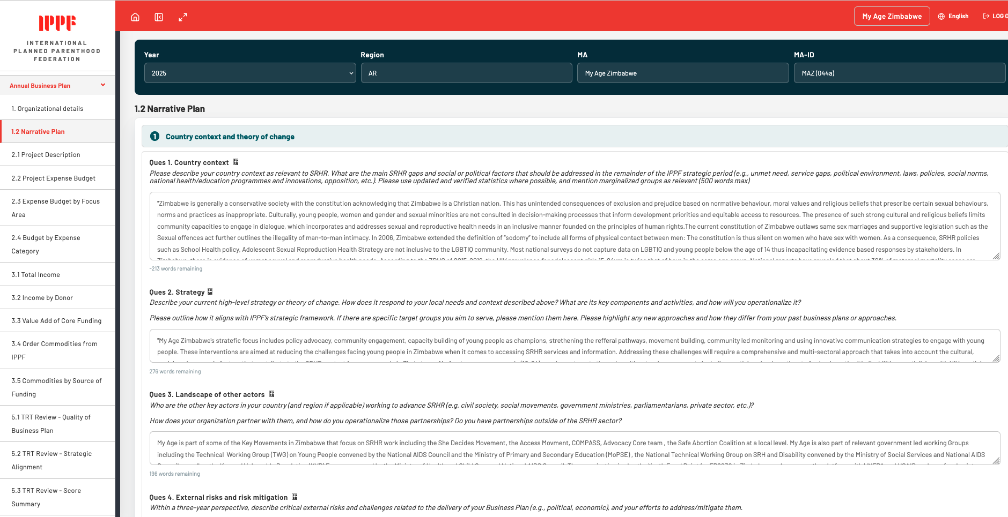
Business Planning

Slide 6
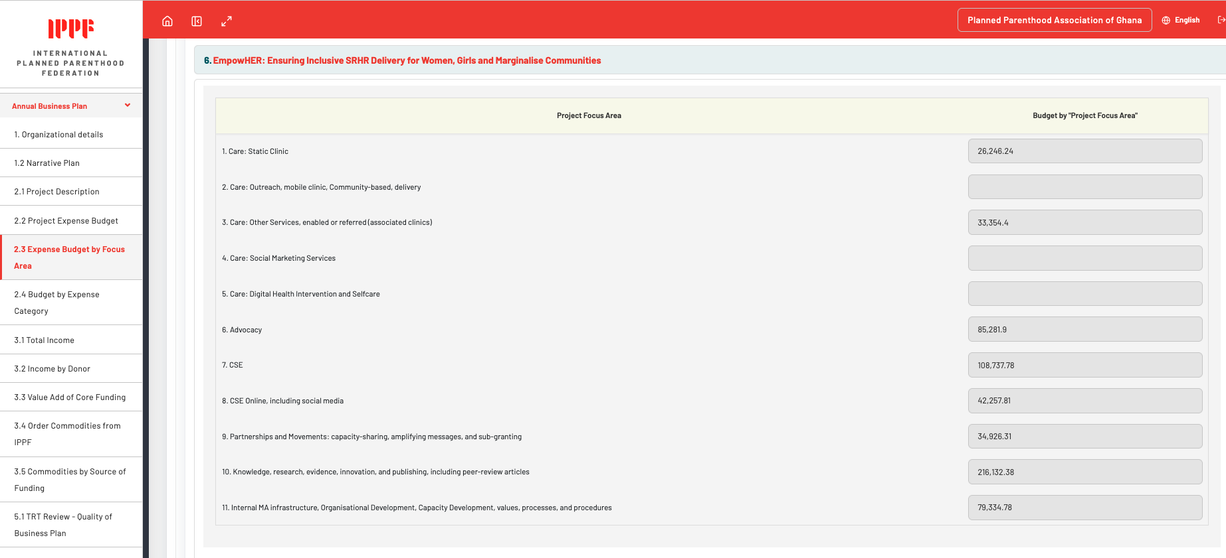
2026 Budgeting

Slide 7
Trends

Slide 8
Stream 1 Allocations: 2026
133 countries with formula-generated allocations
(120 in Stream 1, 13 in Stream 2)
119 Affiliates* eligible to apply for funding
14 no current affiliate
114 submitted business plans
(96 in Stream 1, 13 in Stream 2)
05 Affiliate plans
pending**
114 plans approved (2 with reductions)
*The term ‘affiliation’ describes both Members and CPs. ** due to e.g. late applications, new incoming affiliates, or suspensions.
NB. Data relates to grant-receiving Affiliates only. Data is not limited to IPPF Core – it covers all income and expenditure
.
Notes:
The numbers above reflect several changes:
Cook Islands was originally included in Stream 1 calculations and received an allocation of $113K, but was then moved to Stream 2, for a Affiliatex grant of $75,000, per donor guidelines
Chad, the one country recommended for reduced funding, was recommended to get a 10% cut, which is reflected in the “funding recommended” numbers above

Slide 9
Total expense budget per pillar (2023 - 2026)
Affiliate expense budget by Strategic Pillar
Percentage of projects by Pillars
This refers to the count of number of projects; projects can be tagged to multiple Pillars¹
*The total reported budget for all Affiliates was $ 245,43 Million in 2023 vs $250.92 Million in 2024 vs $265.04 Million in 2025 vs $278.52 Million in 2026

Slide 10
Each region has unique spending trends
% spent on each Pillar by Affiliates in each Region
Pillar 2: Move the Sexuality Agenda
Pillar 3: Solidarity for Change
Pillar 4: Nurture our Federation
Pillar 1: Center Care on People
Notes:
Same formula but only for countries in the regions

Slide 11
Core funding is concentrated in pillar 1
Percentage of core spending by Pillars
Projects can be tagged to multiple Pillars
Core funds gives affiliates flexibly to address funding gaps.
Spending trends across 2023, 2024, and 2025 remain consistent with the original 3-year expense budget.

Slide 12
Project Focus Areas
$ Budgeted spending by Project Focus Area
Number of Affiliates with projects in each Focus Area
Pillar 1: Center Care on People
Pillar 2: Move the Sexuality Agenda
Pillar 3: Solidarity for Change
Pillar 4: Nurture our Federation
The total reported budget for all Affiliates was $ 245,43 Million in 2023 vs $250.92 Million in 2024 vs $265.04 Million in 2025 vs $278.52M in 2026.

Slide 13
Total expected income has grown, driven by non-IPPF restricted donors and social enterprise
Total Affiliate revenue
Affiliate revenue by source

Slide 14
IPPF unrestricted funding is crucial for Affiliates
IPPF unrestricted funding
Number of Affiliates, by percentage share of income
13 affiliates receive over 60% of their funding from IPPF Unrestricted funds
Affiliates that receive more of their funding from IPPF unrestricted tend to have smaller budgets (and smaller Unrestricted grants and Restricted grants)

Slide 15
Thank You

